Slide 1
Fundamentals of Data Science
Ch 1: Data science in a big data world
First Semester 2022/2023

Slide 2
This chapter covers:
Defining data science and big data
Recognizing the different types of data
Gaining insight into the data science process
Introducing the fields of data science and big data
Working through examples of Hadoop

Slide 3
Defining data science
Data science is an evolutionary extension of statistics capable of dealing with the massive amounts of data produced today. It adds methods from computer science to the repertoire of statistics.
The main things that set a data scientist apart from a statistician are the ability to work with big data and experience in machine learning, computing, and algorithm building. Their tools tend to differ too, with data scientist job descriptions more frequently mentioning the ability to use Hadoop, Pig, Spark, R, Python, and Java, among others.

Slide 4
Defining Big data
Big data is a blanket term for any collection of data sets so large or complex that it becomes difficult to process them using traditional data management techniques such as, for example, the RDBMS (relational database management systems). The widely adopted RDBMS has long been regarded as a one-size-fits-all solution, but the demands of handling big data have shown otherwise.
The characteristics of big data are often referred to as the three Vs:
Volume—How much data is there?
Variety—How diverse are different types of data?
Velocity—At what speed is new data generated

Slide 5
Benefits and uses of data science and big data
Data science and big data are used almost everywhere in both commercial and noncommercial settings.
Commercial companies in almost every industry use data science and big data to gain insights into their customers, processes, staff, completion, and products. Many companies use data science to offer customers a better user experience, as well as to cross-sell, up-sell, and personalize their offerings.
Governmental organizations are also aware of data’s value. Many governmental organizations not only rely on internal data scientists to discover valuable information, but also share their data with the public.
Nongovernmental organizations (NGOs) are also no strangers to using data. They use it to raise money and defend their causes
Universities use data science in their research but also to enhance the study experience of their students. The rise of massive open online courses (MOOC) produces a lot of data, which allows universities to study how this type of learning can complement traditional classes

Slide 6
Facets of data
In data science and big data you’ll come across many different types of data, and each of them tends to require different tools and techniques. The main categories of data are these:
Structured
Unstructured
Natural language
Machine-generated
Graph-based
Audio, video, and images
Streaming
Let’s explore all these interesting data types.

Slide 7
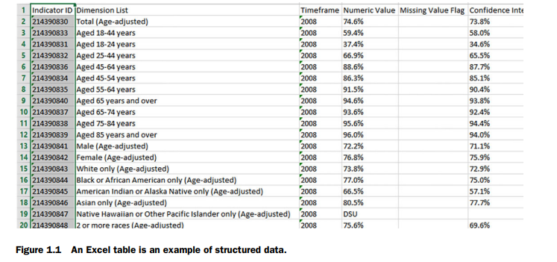
Structured data
Structured data is data that depends on a data model and resides in a fixed field within a record. As such, it’s often easy to store structured data in tables within databases or Excel files (figure 1.1). SQL, or Structured Query Language, is the preferred way to manage and query data that resides in databases.

Slide 8
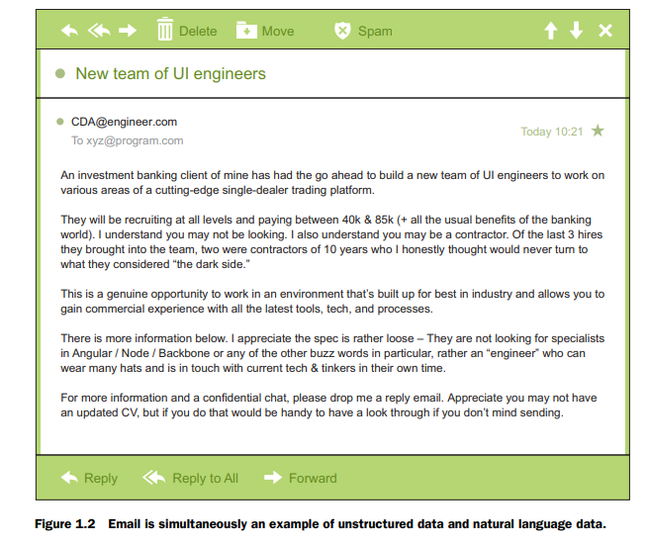
Unstructured data
Unstructured data is data that isn’t easy to fit into a data model because the content is context-specific or varying. One example of unstructured data is your regular email (figure 1.2). Although email contains structured elements such as the sender, title, and body text, it’s a challenge to find the number of people who have written an email complaint about a specific employee because so many ways exist to refer to a person, for example

Slide 9
Natural language
Natural language is a special type of unstructured data; it’s challenging to process because it requires knowledge of specific data science techniques and linguistics.
The natural language processing community has had success in entity recognition, topic recognition, summarization, text completion, and sentiment analysis, but models trained in one domain don’t generalize well to other domains. Even state-of-the-art techniques aren’t able to decipher the meaning of every piece of text.

Slide 10
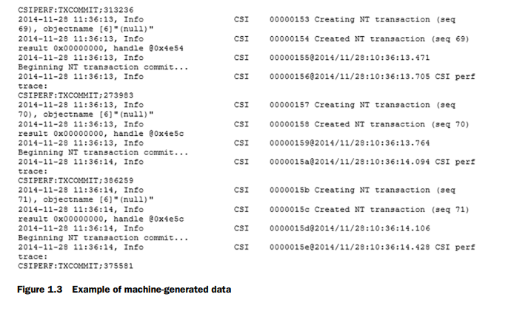
Machine-generated data
Machine-generated data is information that’s automatically created by a computer, process, application, or other machine without human intervention. Machine-generated data is becoming a major data resource and will continue to do so.
The analysis of machine data relies on highly scalable tools, due to its high volume and speed. Examples of machine data are web server logs, call detail records, network event logs, and telemetry (figure 1.3).

Slide 11
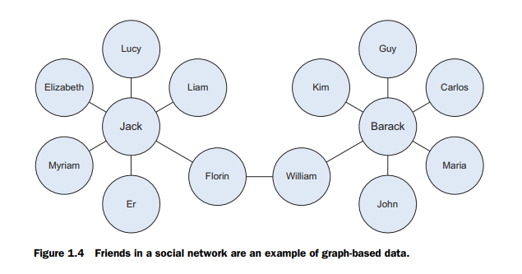
Graph-based or network data
“Graph data” can be a confusing term because any data can be shown in a graph. “Graph” in this case points to mathematical graph theory. In graph theory, a graph is a mathematical structure to model pair-wise relationships between objects. Graph or network data is, in short, data that focuses on the relationship or adjacency of objects. The graph structures use nodes, edges, and properties to represent and store graphical data.
Graph-based data is a natural way to represent social networks, and its structure allows you to calculate specific metrics such as the influence of a person and the shortest path between two people.
Examples of graph-based data can be found on many social media websites (figure 1.4). For instance, on LinkedIn you can see who you know at which company. Your follower list on Twitter is another example of graph-based data.

Slide 12
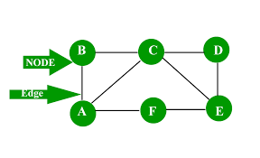
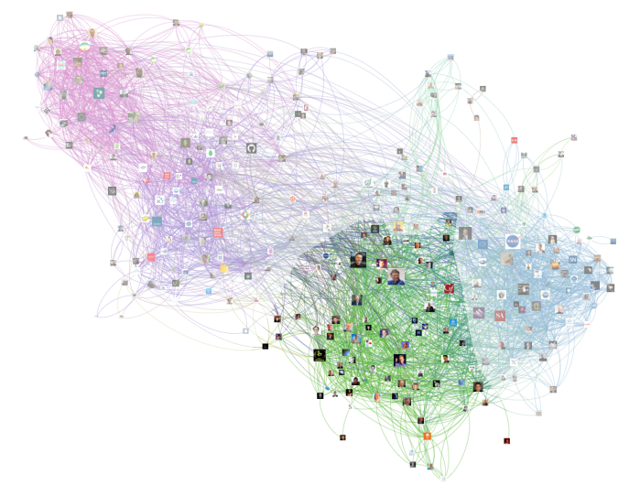
Graph-based data
graph theory

Slide 13
Audio, image, and video
Audio, image, and video are data types that pose specific challenges to a data scientist. Tasks that are trivial for humans, such as recognizing objects in pictures, turn out to be challenging for computers.
For example, MLBAM (Major League Baseball Advanced Media) announced in 2014 that they’ll increase video capture to approximately 7 TB per game for the purpose of live, in-game analytics. High-speed cameras at stadiums will capture ball and athlete movements to calculate in real time, for example, the path taken by a defender relative to two baselines.
Recently a company called DeepMind succeeded at creating an algorithm that’s capable of learning how to play video games. This algorithm takes the video screen as input and learns to interpret everything via a complex process of deep learning. It’s a remarkable feat that prompted Google to buy the company for their own Artificial Intelligence (AI) development plans. The learning algorithm takes in data as it’s produced by the computer game; it’s streaming data.

Slide 14
Streaming data
While streaming data can take almost any of the previous forms, it has an extra property. The data flows into the system when an event happens instead of being loaded into a data store in a batch. Although this isn’t really a different type of data, we treat it here as such because you need to adapt your process to deal with this type of information.
Examples are the “What’s trending” on Twitter, live sporting or music events, and the stock market.

Slide 15
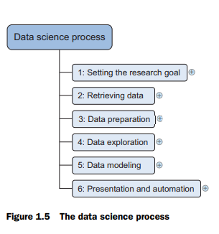
The data science process
The data science process typically consists of six steps, as you can see in the mind map in figure 1.5. We will introduce them briefly here and handle them in more detail in chapter 2.

Slide 16
The big data ecosystem and data science
Currently many big data tools and frameworks exist, and it’s easy to get lost because new technologies appear rapidly.
It’s much easier once you realize that the big data ecosystem can be grouped into technologies that have similar goals and functionalities, which we’ll discuss in this section.
Data scientists use many different technologies, but not all of them; we’ll dedicate a separate chapter to the most important data science technology classes.
The mind map in figure 1.6 shows the components of the big data ecosystem and where the different technologies belong. Let’s look at the different groups of tools in this diagram and see what each does. We’ll start with distributed file systems

Slide 17
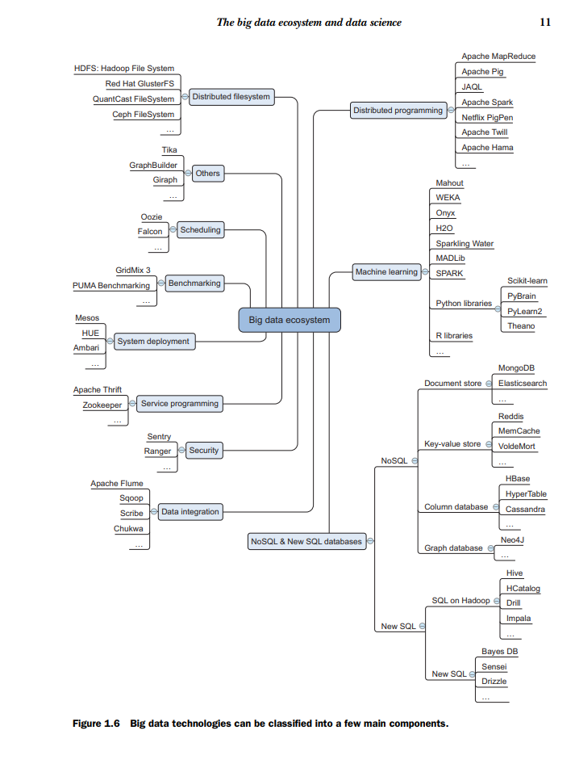

Slide 18
Distributed file systems
A distributed file system is similar to a normal file system, except that it runs on multiple servers at once. Because it’s a file system, you can do almost all the same things you’d do on a normal file system. Actions such as storing, reading, and deleting files and adding security to files are at the core of every file system, including the distributed one.
Distributed file systems have significant advantages:
They can store files larger than any one computer disk.
Files get automatically replicated across multiple servers for redundancy or parallel operations while hiding the complexity of doing so from the user.
The system scales easily: you’re no longer bound by the memory or storage restrictions of a single server.
The best-known distributed file system at this moment is the Hadoop File System (HDFS). It is an open-source implementation of the Google File System.
In this course, we focus on the Hadoop File System because it is the most common one in use. However, many other distributed file systems exist: Red Hat Cluster File System, Ceph File System, and Tachyon File System, to name but three.

Slide 19
Distributed programming framework
Once you have the data stored on the distributed file system, you want to exploit it. One important aspect of working on a distributed hard disk is that you won’t move your data to your program, but rather you’ll move your program to the data.

Slide 20
Data integration framework
Once you have a distributed file system in place, you need to add data. You need to move data from one source to another, and this is where the data integration frameworks. The process is similar to an extract, transform, and load process in a traditional data warehouse

Slide 21
Machine learning frameworks
When you have the data in place, it’s time to extract the coveted insights. This is where you rely on the fields of machine learning, statistics, and applied mathematics

Slide 22
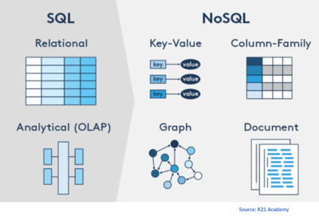
NoSQL databases
If you need to store huge amounts of data, you require software that’s specialized in managing and querying this data. Traditionally this has been the playing field of relational databases such as Oracle SQL, MySQL, Sybase IQ, and others. While they’re still the go-to technology for many use cases, new types of databases have emerged under the grouping of NoSQL databases.
The name of this group can be misleading, as “No” in this context stands for “Not Only.”
NoSQL databases allow for a virtually endless growth of data. These shortcomings relate to every property of big data: their storage or processing power can’t scale beyond a single node and they have no way to handle streaming, graph, or unstructured forms of data.

Slide 23
